Slide 1

LECTURE 04
Digital Logic Design

Slide 2
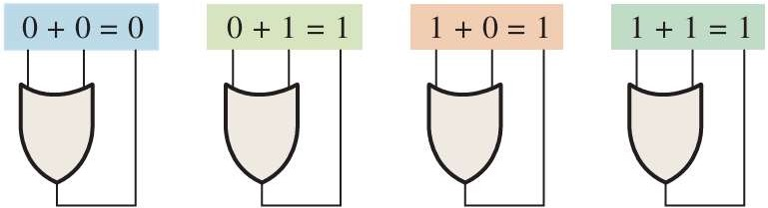
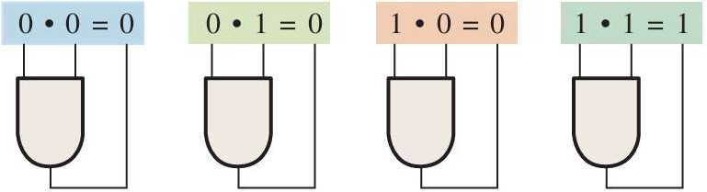
BOOLEAN ALGEBRA
Boolean algebra is the mathematics of digital logic. A basic knowledge of Boolean algebra is indispensable to the study and analysis of logic circuits.

Slide 3
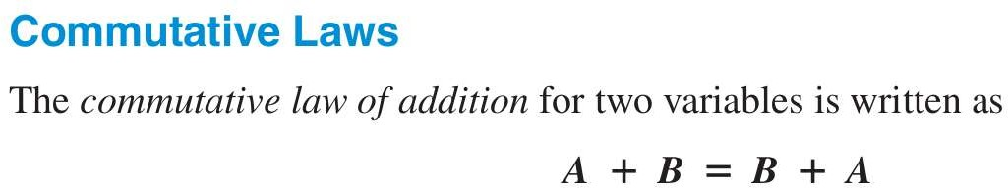
BASIC LAWS
The basic laws of Boolean algebra—the commutative laws for addition and multiplication, the associative laws for addition and multiplication, and the distributive law—are the same as in ordinary algebra.

Slide 4
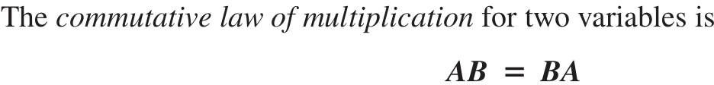
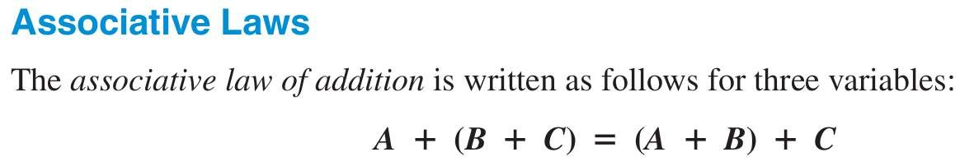
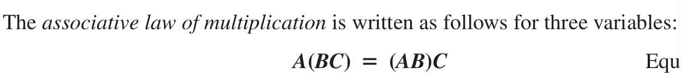

Slide 5
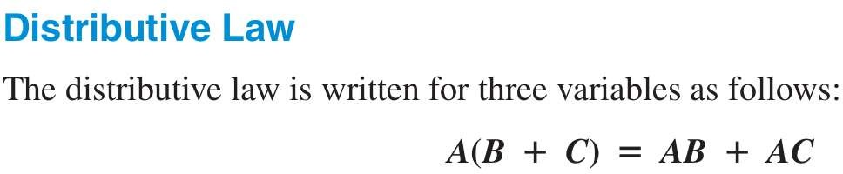

Slide 6
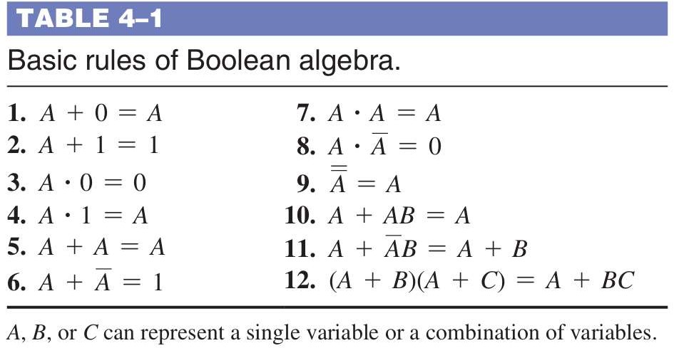
BASIC RULES OF BOOLEAN ALGEBRA

Slide 7
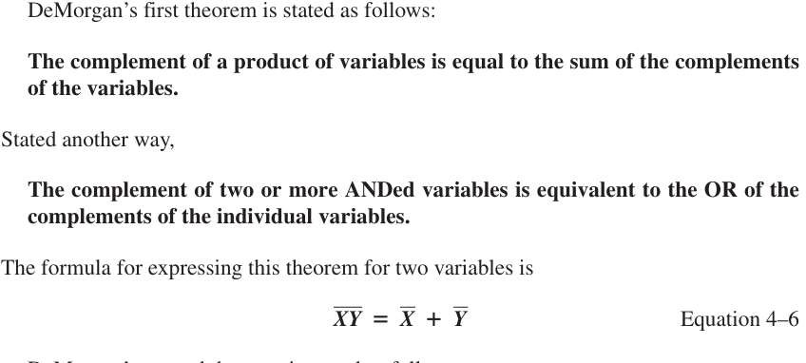
DE MORGAN THEOREM

Slide 8
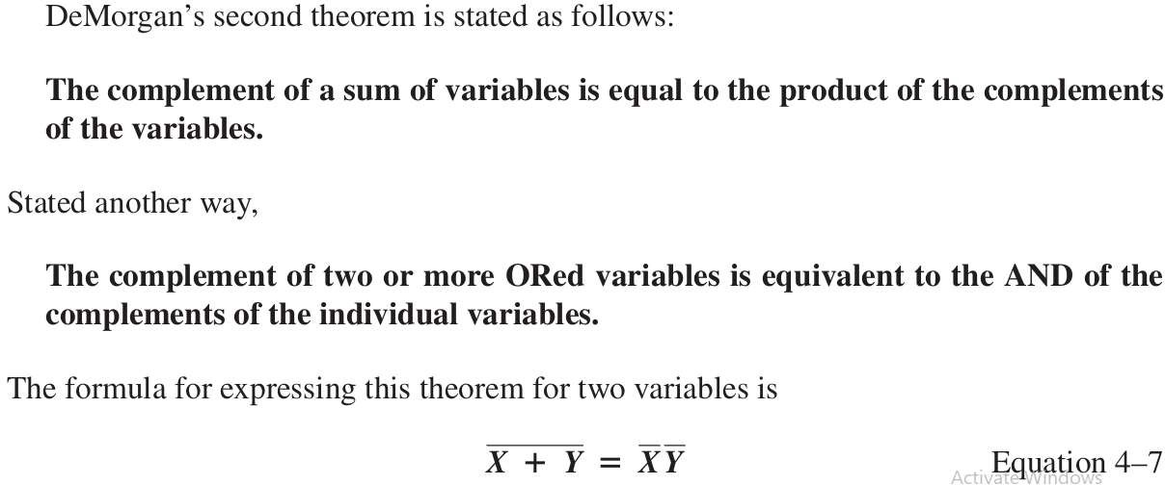

Slide 9
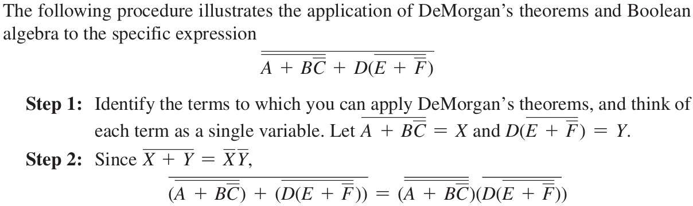

Slide 10
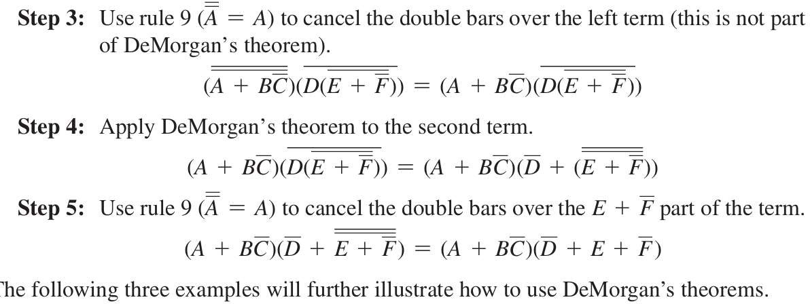

Slide 11
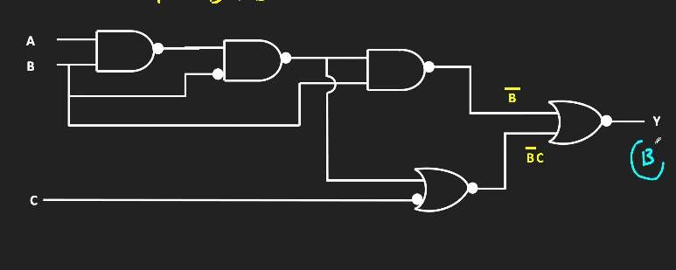
SIMPLIFY CIRCUIT USING BOOLEAN ALGEBRA

Slide 12

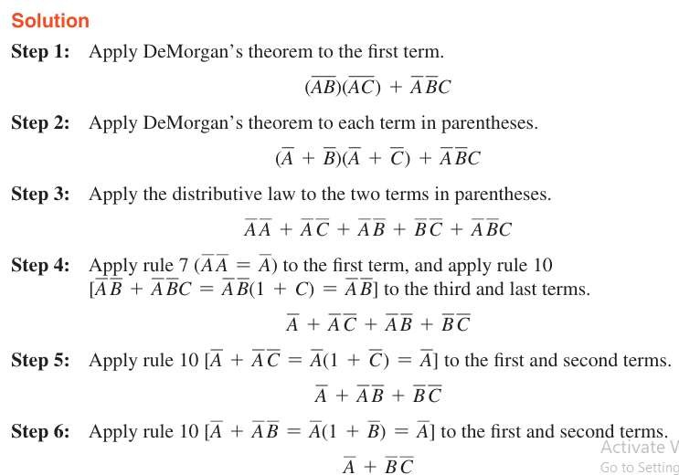

Slide 13
QUESTIONS

Slide 14
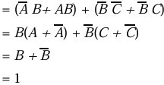
SIMPLIFICATION OF BOOLEAN EXPRESSION

Slide 15

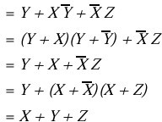

Slide 16

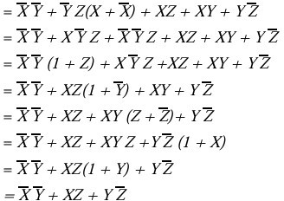

Slide 17
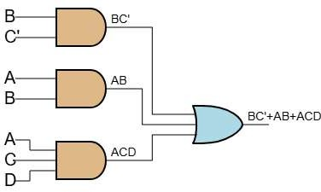
DRAWING LOGIC DIAGRAM FROM BOOLEAN EXPRESSION
𝐵𝐶̅ + 𝐴𝐵 + 𝐴𝐶𝐷

Slide 18
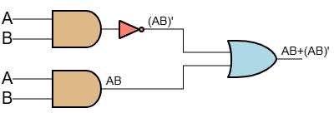

Slide 19
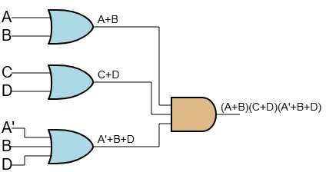
𝐴 + 𝐵 𝐶 + 𝐷 𝐴̅ + 𝐵 + 𝐷

Slide 20
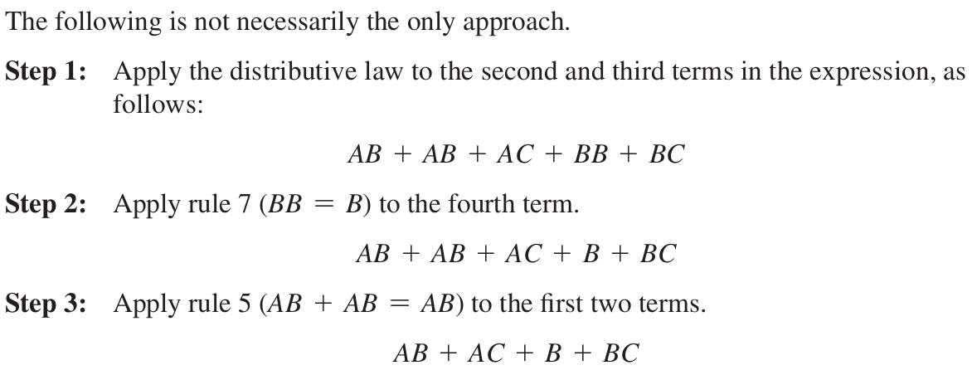
Using Boolean algebra techniques, simplify this expression: AB+A(B+C)+B(B+C)

Slide 21
